Slide 1


WKRDBES-INTRO3
2024
Henrik Kjems-Nielsen
ICES Secretariat

Slide 2
Reasons for developing RDBES
Provide a regional estimation system for ICES stock assessments – including the possibility for statistical estimations
Give Regional Coordination Groups access to detailed data in the way it was collected
Support data from design-based sampling collections
To increase the data quality, documentation of data, and transparency of estimations
To facilitate the production of fisheries management advice and reports
To increase the awareness of fisheries data collected and the overall usage of these data.

Slide 3
Commercial fisheries data today (RDBES IC)
Transparent data and raising/estimations
National raising/est. procedures (not known/transparent)
National DBs
InterCatch
Known standardised raising/ estimation procedures
ICES EG
Advice
RDBES
RCGs
Baltic, NA, NS & EA, LDF
EU

Slide 4
Commercial fisheries future (RDBES)
Transparent data and raising/estimations
National DBs
WGRDBESStockCoord and Data Compilation/Benchmark Workshop writing raising/estimation procedures in TAF
Data call upload
RDBES
ICES EG
Advice
Potentially: Annual reports, FDI
RCGs
Baltic, NA, NS & EA, LDF
EU

Slide 5
How is the RDBES specified and developed
The Core Group specifies the data model and the documentation. The Core Group is a subgroup of the WGRDBESGOV and the official name is ‘RDBES development support group’. The meetings are chaired by ICES Sec. and the last 4½ year there have been about 140 online meetings
ICES Sec. is then according the specifications developing the RDBES
ICES Sec. are sending out the RDBES data call, which so far have been specified by the WGRDBESGOV

Slide 6
The participants of the Core Group
Henrik Kjems-Nielsen, ICES, chair Henrikkn@ices.dk
Kirsten Birch Håkansson, DTU Aqua, Denmark Kibi@aqua.dtu.dk
Nuno Prista, SLU Aqua, Sweden Nuno.prista@slu.se
David Currie, Marine Institute, Ireland David.Currie@Marine.ie
Liz Clarke, Marine Scotland, Scotland Liz.Clarke@gov.scot
Josefine Egekvist, DTU Aqua, Denmark Jsv@aqua.dtu.dk
Karolina Molla Gazi, WUR, Netherlands Karolina.mollagazi@wur.nl
Ana Claudia Fernandes, IPMA, Portugal Acfernandes@ipma.pt
Marta Suska, MIR, Poland Msuska@mir.gdynia.pl
Jonathan Rault, ifremer, France Jonathan.rault@ifremer.fr
All countries can participate in the Core Group and contribute to the specifications and testing of the RDBES.

Slide 7
The RDBES data model
The RDBES data model consists of different data types
Commercial Landing (CL) and effort (CE)
Vessel detail (VD) and Species List (SL)
Commercial Sampling (CS) which consists of many tables, starting with Design (DE), Sampling Details (SD), etc. and end with Sample (SA), Frequency Measure (FM) or Biological Variable (BV)

Slide 8
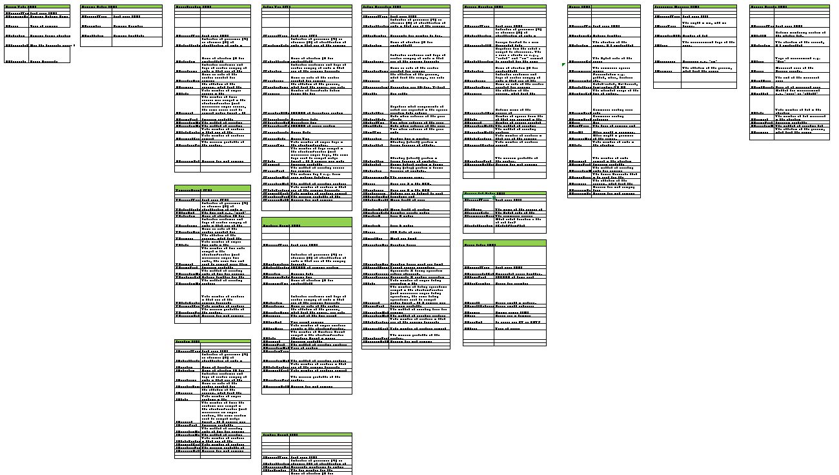
RDBES covers all commercial sampling types
RDBES data model
This model is the first that covers all countries and potentially all species.
15 tables, combined in 52 different hierarchies

Slide 9
13 Upper hierarchies
Hierarchy 1 | Hierarchy 2 | Hierarchy 3 | Hierarchy 4 | Hierarchy 5 | Hierarchy 6 | Hierarchy 7 | Hierarchy 8 | Hierarchy 9 | Hierarchy 10 | Hierarchy 11 | Hierarchy 12 | Hierarchy 13
Design | Design | Design | Design | Design | Design | Design | Design | Design | Design | Design | Design | Design
Sampling Details | Sampling Details | Sampling Details | Sampling Details | Sampling Details | Sampling Details | Sampling details | Sampling details | Sampling details | Sampling details | Sampling details | Sampling details | Sampling details
Vessel Selection | Fishing Trip | Temporal Event | On-shore | On-shore | On-shore | On-shore | Temporal Event | Landing location | Vessel Selection | Location | Location | Fishing Operation
Fishing Trip | Fishing Operation | Vessel Selection | Fishing Trip | Landing Event | Fishing Trip | Landing Event (b) | Vessel Selection | Temporal event | Temporal Event | Temporal Event | Temporal Event | Species Selection
Fishing Operation | Species Selection | Fishing Trip | Landing Event | Species Selection | Fishing Operation (a) | Species Selection | Landing Event | Species selection | Fishing Trip | Fishing Trip | Landing Event | Sample
Species Selection | Sample | Fishing Operation | Species Selection | Sample | Species Selection | Sample | Species selection | Landing Event (b) | Fishing Operation | Landing Event | Species Selection
Sample |  | Species Selection | Sample |  | Sample |  | Sample | Sample | Species Selection | Species Selection | Sample
 |  | Sample |  |  |  |  |  |  | Sample | Sample
(a) only FOaggregationLevel ==T
(b) LE is not a part of the estimation hierarchy, , please see annex for the specific hierarchy 7and 9

Slide 10
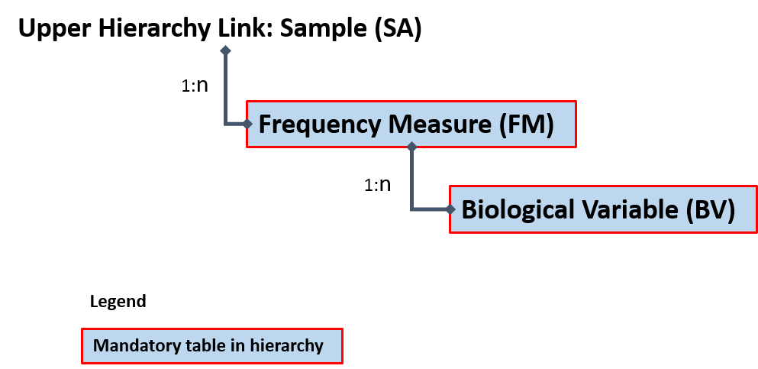
Lower hierarchies
Lower hierarchy tables:
Frequency Measure (FM)
Biological Variable (BV)
 | Lower Hierarchy A | Lower Hierarchy B | Lower Hierarchy C | Lower Hierarchy D
Tables in the lower hierarchy | Frequency Measure | Frequency Measure | Biological Variable
 | Biological Variable

Slide 11
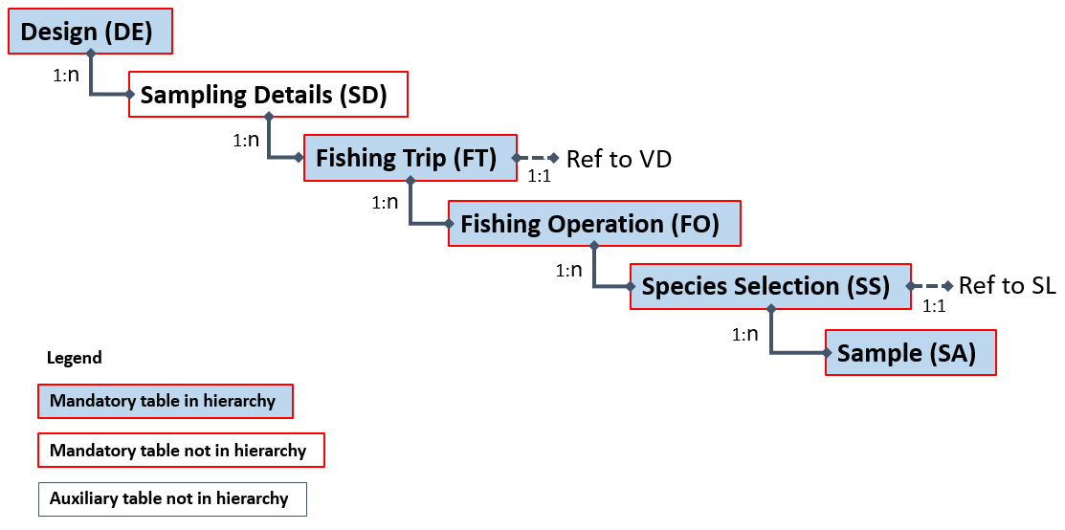
RDBES table relations for 1 of the 13 sampling structures/hierarchies
Hierarchy 2 as example

Slide 12
RDBES workshops in 2024
Stock coordinators can attend the WKRDBES_RaiseStock online 10-11 June and 18-19 Nov., where estimations will be done for the Northeast Atlantic mackerel (mac.27.nea) using R scripts that start from national RDBES data.
  Chaired by David Currie, Ireland, and Siobhan Moran, Ireland
National estimators can attend the WKNatEst online 24–28 June, where R scripts will be develop and share for national estimates of landings, discards and biological data, using the RDBES format.
  Chaired by Jessica Craig (UK-Scotland) and Ana Ribeiro Santos (UK-England)
Data submitters and national estimator can attend WKRDBES-INTRO online 24th – 26th Sep., where they will be introduced to the RDBES data model/format.
  Chaired by Henrik Kjems-Nielsen, ICES
Stock coordinators can attend the WGRDBESStockCoord online 21st – 25th October to finalise the Regional Catch Estimation Format, RCEF, and develop stock estimation R-functions in RDBESstockCoord package.
  Chaired by Sofie Nimmegeers, Belgium and Kirsten Birch Håkansson, Denmark
If stock coordinators/persons have interest and are skilled in writing R scripts, then they can attend the WGRDBES-EST 14th – 18th October in Lisbon to work on developing statistical and ratio estimations in R scripts from the RDBES data.
  Chaired by Ana Claúdia Fernandes, Portugal, and Richard Meitern, Estonia
At data compilation/benchmark WKs stock coordinators and stock assessors should also write raising/estimation procedures in R scripts in TAF

Slide 13
Functionalities needed (WGRDBESGOV)
Short term developments
Upload log; which explains the completeness of the countries’ data upload
Develop roles further for access, viewing and download of data
Split of species list
Data validation only
Stock definition list module
Recreational fisheries data implemented in the RDBES
FDI data export

Slide 14
Where to get information
To access the RDBES:
  https://rdbes.ices.dk
Information on the data mode/format and documentation:
  https://github.com/ices-tools-dev/RDBES
Code lists:
  https://vocab.ices.dk/
Issues regarding getting data into the right hierarchy etc.
  https://github.com/ices-tools-dev/RDBES/issues
Technical issues problems uploading files or missing codes etc.
  RDBsupport@ices.dk

Slide 15
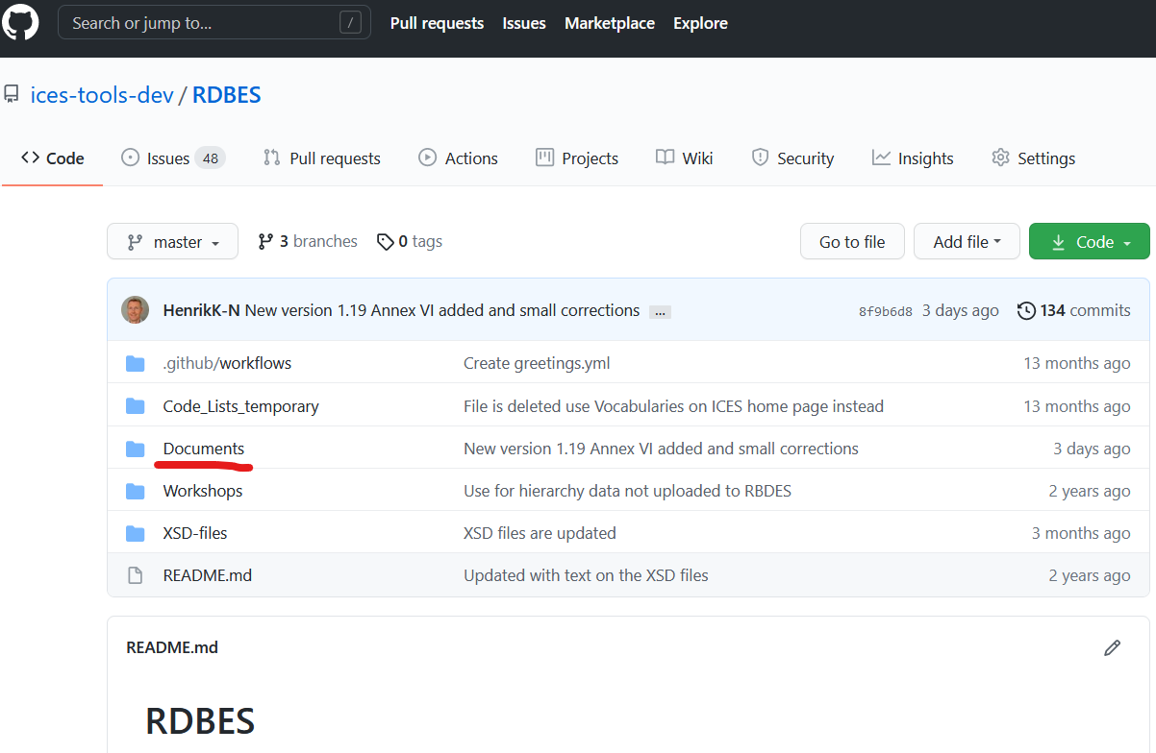
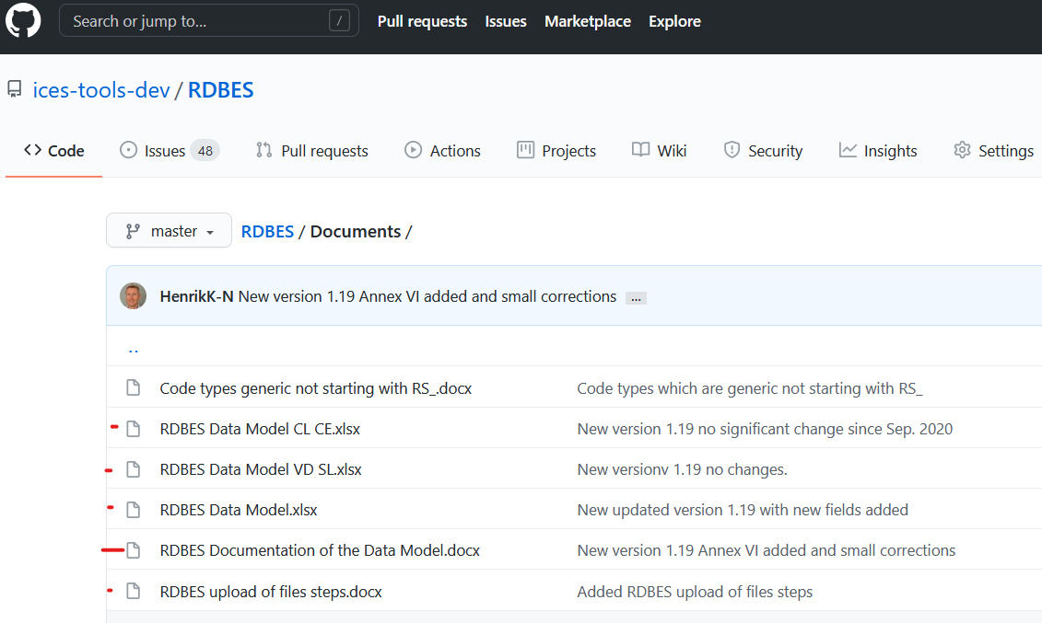
What are the steps? 1) Look into the data model
Start by downloading the data model Information on the data model/format and documentation:
  https://github.com/ices-tools-dev/RDBES

Slide 16
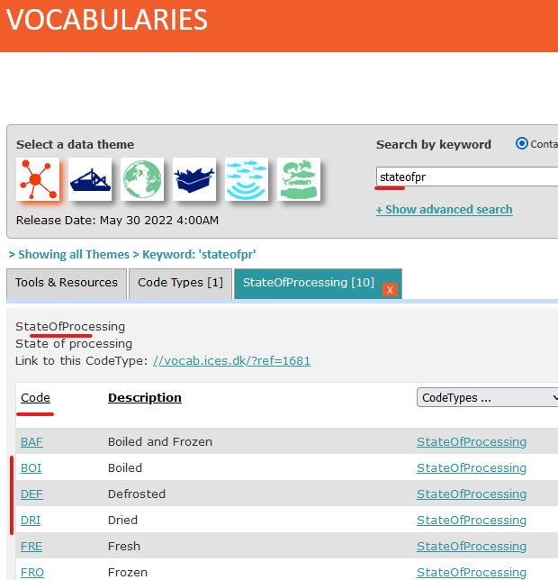
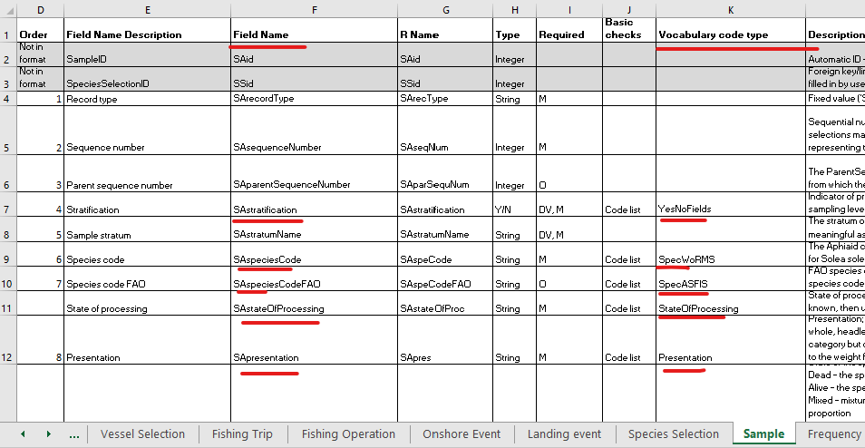
2) Find the available codes
Find out which code to use for the data upload
Code lists: https://vocab.ices.dk/

Slide 17
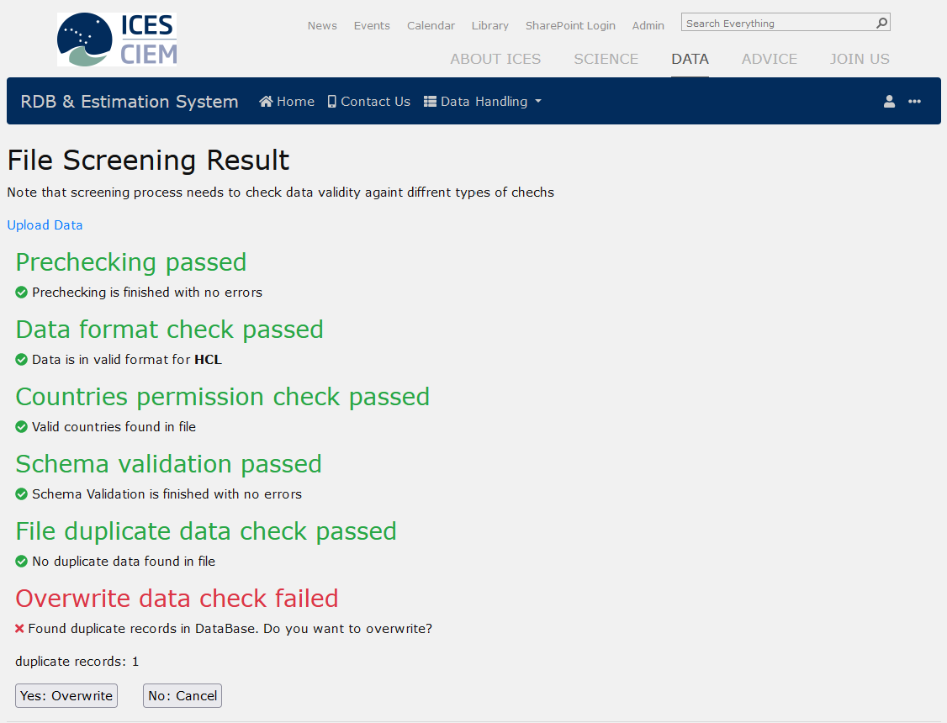
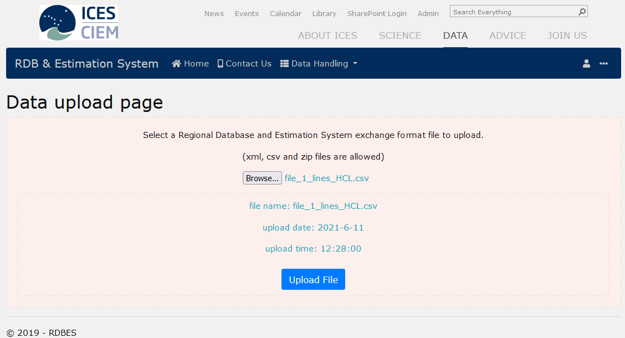
3) Upload the data
Ask for access to the RDBES at: RDBsupport@ices.dk
Log into the RDBES and upload data files according to the order of files (doc. on RDBES GitHub)
To access the RDBES:
  https://rdbes.ices.dk

Slide 18
4) If issues arises
Issues regarding:
  Getting data into the right hierarchy
  How to fill in the fields in Fishing Operation records or Sample records according to how the data was collected etc.
  https://github.com/ices-tools-dev/RDBES/issues
Technical issues:
  Missing codes according to the code list in the vocabulary
  Problems uploading files etc.
  RDBsupport@ices.dk

Slide 19
The use of the RDBES
The process of start using the RDBES
Data submitters/countries upload all species data to the RDBES including commercial and bycatch according to the RCG ICES RDBES data call, which will substitute the ICES data call to InterCatch. This year the RCG ICES RDBES data call substituted the Regional Coordination Groups’ data call to the RDB.
National estimators will do the estimations/raising to InterCatch input level (data by quarter and subdivision) in TAF using the Regional Catch Estimates Format, RCEF.
A the WGRDBESStockCoord online 21–25 Oct. and WKRDBES_RaiseStock online 18-19 Nov. and at the relevant data compilation/benchmark workshop stock coordinators and national estimators will start using the RDBES data in the Transparent Assessment Framework, TAF. At the two WK and the benchmark workshop R estimations script will be made, generic R scripts from WGRDBES-EST can be copied for a start for stock coordinators. When the specific R estimation scripts have been verified for use in the WG. The WG can start using the data from the RDBES and the R estimation script in TAF to create the input data for the assessment. By the input data is meant total catch, numbers and mean weight at age or numbers at length, just like the InterCatch output, see the Stock Coordination Format, SCF.

Slide 20
Commercial fisheries future (RDBES)
Transparent data and raising/estimations
National DBs
WKRDBES-RAISE&TAF and Data Compilation/Benchmark Workshop writing raising/estimation procedures in TAF
RDBES
ICES EG
Advice
Potentially: Annual reports, FDI
RCGs
Baltic, NA, NS & EA, LDF
EU

Slide 21
3 loops in TAF
3
Data is going through TAF 3 times.
2
1
RDBES data
TAF
Assessment
Depending on the stock category, but for category 1 stocks:
The persons at the national institute who does the national estimation to the InterCatch input level (typically landing, effort and sampling at quarter, subdivision and metierlvl6) now RCEF.
The Stock Coordinator estimating discard and age or length distributions for the stock (equivalent to the estimation in InterCatch), now SCF.
The Stock Assessors modelling/estimating stock data.

Slide 22
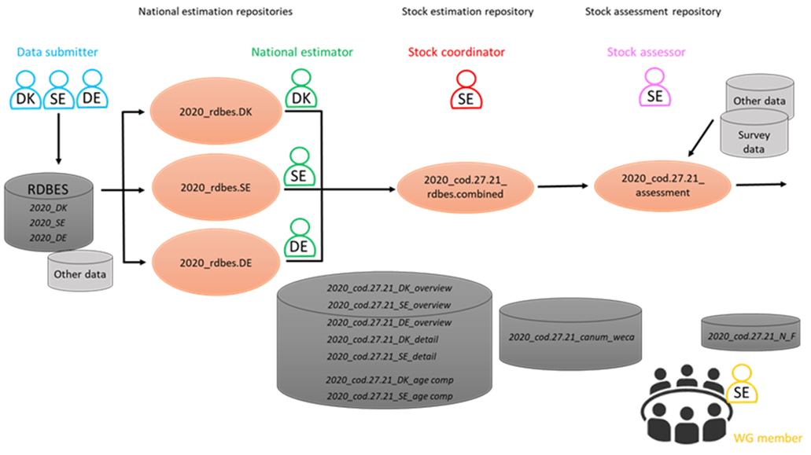
Repositories suggested from WKRDBES-Raise&TAF

Slide 23
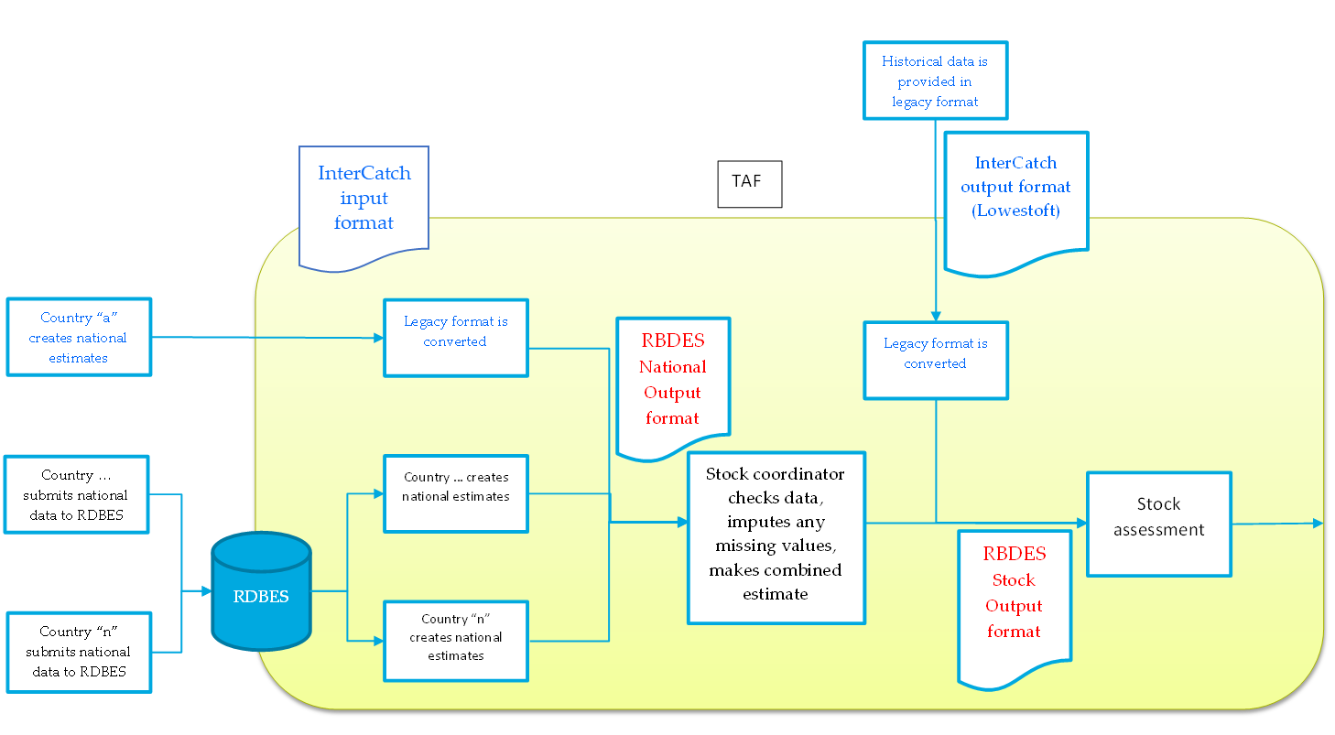
Preparing input to assessment with RDBES/TAF
WGRDBESGOV report 2021

Slide 24
Data Call 2024 all species used for assessment
The RCG and ICES have specified the data call and data will be used for stock assessment
The sample data requested in the data call is for all species and incidental bycatch
The data call was sent 29th January 2024 with a deadline of 2nd April 2024

Slide 25

RDBES road map - substitute InterCatch and the RDB
 | 2024 | 2025 | 2026 | 2027
RDB | Data download | Data download | Data download | Data download
InterCatch | Data uploaded & download* | Data uploaded & download* | Data uploaded & download* | Data download
RDBES | Data uploaded & download | Data uploaded & download | Data uploaded & download | Data uploaded & download
RDBES Data Calls | . Joint RCG-ICES RDBES DC (April) . HAWG RDBES data calls (n=2) (autumn) . RCG LDF RDBES DC (tbd) | . Joint RCG-ICES RDBES DC (TBD) . RDBES older data? (TBD) . RCG LDF RDBES DC (TBD) | . Joint RCG-ICES RDBES DC (TBD) . RDBES older data? (TBD) . RCG LDF RDBES DC (TBD) | . Joint RCG-ICES RDBES DC (TBD) . RDBES older data? (TBD) . RCG LDF RDBES DC (TBD)
Other Data Calls | . ICES Fisheries DC . ICES Recreational DC . ICES WGBYC DC | . ICES Fisheries DC . ICES Recreational DC . ICES WGBYC DC | . ICES Fisheries DC . ICES Recreational DC . ICES WGBYC DC
Use of RDBES in stock assessment | . Test of RDBES uploads and estimations ahead of some stock assessment groups | . Test of RDBES uploads and estimations ahead of some stock assessment groups | . Test of RDBES uploads and estimations ahead of some stock assessment groups | . Use of RDBES data in the assessment of stocks currently uploaded to IC (in TAF)
ICES & DCF Community | . WGRDBES-EST . WGRDBES-StockCoord (tbc) . WKRDBES-RaiseStock1 (tbc) . WKRDBES-INTRO . WGRDBESGOV – ISSG Quality - WGRDBESGOV – ISSG Format - WGRDBESGOV Core Group | . WGRDBES-EST . WGRDBES-StockCoord (tbc) . WKRDBES-RaiseStock2 (tbc) . … | . WGRDBES-EST . WGRDBES-StockCoord (tbc) . WKRDBES-RaiseStock3 (tbc) . … | . TBD
Deliverables | . R Package RDBEScore update . R Package RDBESvisualize launch . R Package RDBESstockCoord start | . R Package RDBEScore update, . R Package RDBESvisualize update . R Package RDBESstockCoord launch | . R Package RDBEScore update, . R Package RDBESvisualize update . R Package RDBESstockCoord update | . TBD
* IC/WGBYC DB Progressively phasing out: the new estimates for some stocks will not be available in IC

Slide 26
Conclusion
The RDBES is being specified by the Core Group, who are doing a fantastic job. Countries have given feedback, which is incorporated, all countries support the data model.
The RDBES web system is developed by ICES Secretariat
5 WK in 2024: WKRDBES_RaiseStock, WKNatEst, WKRDB-INTRO, WGRDBESStockCoord and WGRDBES-EST
  The RDBES is offline for updates around end Nov. 2024 to end Jan 2025. at: https://rdbes.ices.dk
The next data call for the RDBES for all species will be send around end January 2025, with a dead line around 1st April.
In 2024-26 RDBES and InterCatch will run in parallel, in 2027 only the RDBES will be used

